Slide 1
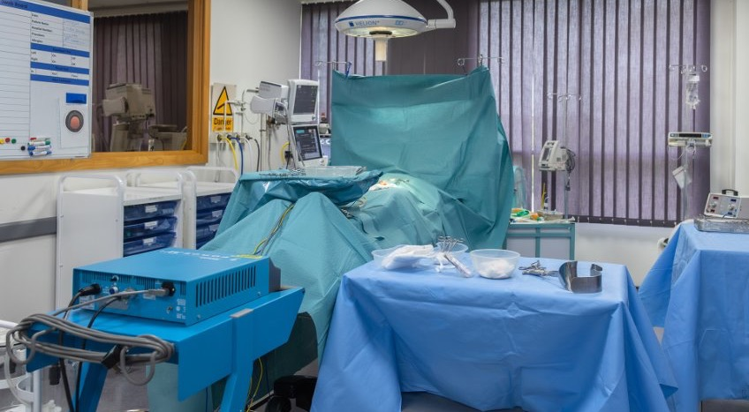

Cover page for Supportive Resources
Thank you for joining us
from the ODP SURGE project team

Slide 2
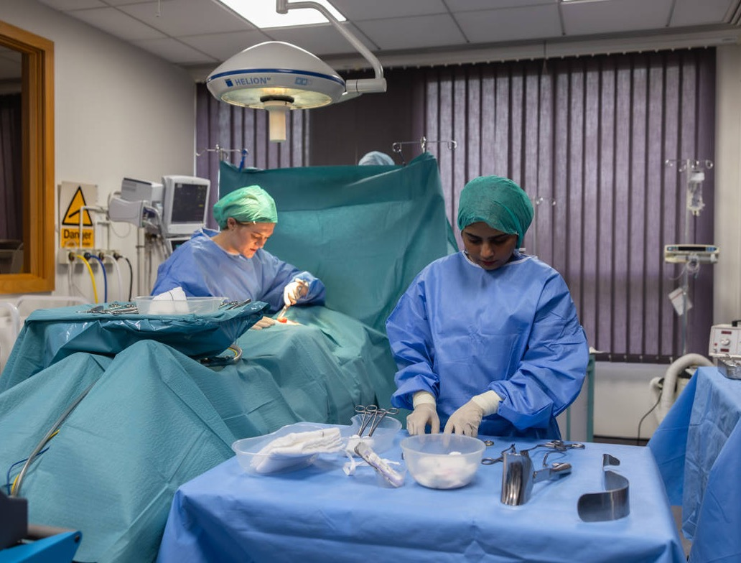
Learning Outcomes
Inside the Operating Theatre: Before, During and After Surgery – Ensuring Compassionate, Safe and Dignified Treatment and Care with Kris Birney and Christina Doyle from ODP SURGE
Understand the role of the ODP
Develop insight into the complexity of potential untoward events during the perioperative period
Appreciate the need for multidisciplinary and communication in operating theatre environment
Learn about safety principles such as WHO surgical safety checklist

Slide 3
Overview of Webinar
Inside the Operating Theatre: Before, During and After Surgery – Ensuring Compassionate, Safe and Dignified Treatment and Care with Kris Birney and Christina Doyle from ODP SURGE
This handout supports the taster session. It introduces the role, skills, and career pathways of ODPs and helps you reflect on the experience for applications and careers planning.
What is an Operating Department Practitioner?
Operating Department Practitioners (ODPs) are registered healthcare professionals who are trained to provide perioperative care as part of the wider team. They care for patients before, during, and after surgery: ensuring safety, dignity, and high-quality care.
Where do ODPs work?
• Operating theatres: in anaesthetic, scrub/circulating and post-anaesthesia care roles
• Emergency and trauma settings
• Critical care
Key Skills and Attributes
• Communication and teamwork
• Calm decision-making under pressure
• Situational awareness and patient advocacy
• Technical and practical skills
• Compassion and professionalism
How ODPs Support a Patient
Before surgery: Equipment and safety checks, patient reassurance, preparation.
During surgery: Supporting anaesthesia and surgery, monitoring patient safety.
After surgery: Recovery care, monitoring, and effective handover.
Routes into Operating Department Practice
• BSc (Hons) Operating Department Practice via UCAS
• Degree Apprenticeship (earn while you learn)
Salary and Career Progression
Newly qualified ODPs usually start at NHS Band 5. With experience, ODPs can progress into advanced clinical practice, education, leadership, research, and specialist roles.
Next Steps
• Explore NHS Careers: Operating Department Practitioner
• Attend open days or taster sessions
• Speak to careers advisers or university representatives

Slide 4
Reflective Tool for Webinar
Inside the Operating Theatre: Before, During and After Surgery – Ensuring Compassionate, Safe and Dignified Treatment and Care with Kris Birney and Christina Doyle from ODP SURGE
Using This Session in Applications/Personal Statement: ABC Reflection
Taster sessions such as this, provide opportunities to explore different areas of interest and knowledge, allowing participants to explore future possibilities.
Having attended a session and if wishing to use for evidence to demonstrate interest in a particular field, it is useful to consider reflective tools to break down the experience and then using this to summarise in your own words to use within applications or personal statements (such as that required for university applications).
The table below can be used as a template for this.
ACTIVITY What was the session about? Who delivered the session? (give names/details)
BENEFIT What knowledge did you gain? What specifically interested you?
COURSE How will the knowledge gained help towards the course? What areas are you looking forward to finding out more about?

Slide 5

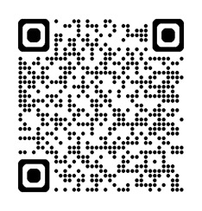
More information
NHS Careers website
Operating department practitioner | Health Careers
National Careers Service
https://nationalcareers.service.gov.uk/job-profiles/operating-department-practitioner
College of Operating Department Practitioners
College of Operating Department Practitioners
Interactive resource to look inside an Operating Theatre (shared with kind permission of the Health e-learning and Media team at University of Nottingham, helm@nottingham.ac.uk)
Operating Theatre Orientation
ODP SURGE project
kris.birney@canterbury.ac.uk / christina.doyle@canterbury.ac.uk
Project newsletter accessed by scanning QR code
Notes:
---

